Slide 1
Satellite Communication and the world of RF
By: Edrik Vachier
Mentors: Dr. Sean Bryan and Mr. Scott Smas
School of Earth and Space Exploration
Arizona state university Student Research Symposium
April 21-22, 2023

Slide 2
Overview of Research Objectives
Understanding the implications of radio frequency and data transmission
Simulating transmission and reception of data in an undisturbed environment and observing waveforms using idealized modulation schemes
Transmitting and receiving a signal from two configured B210 devices (capable of transmission and reception)
Formulating action steps for an ASU Satellite Ground Station

Slide 3
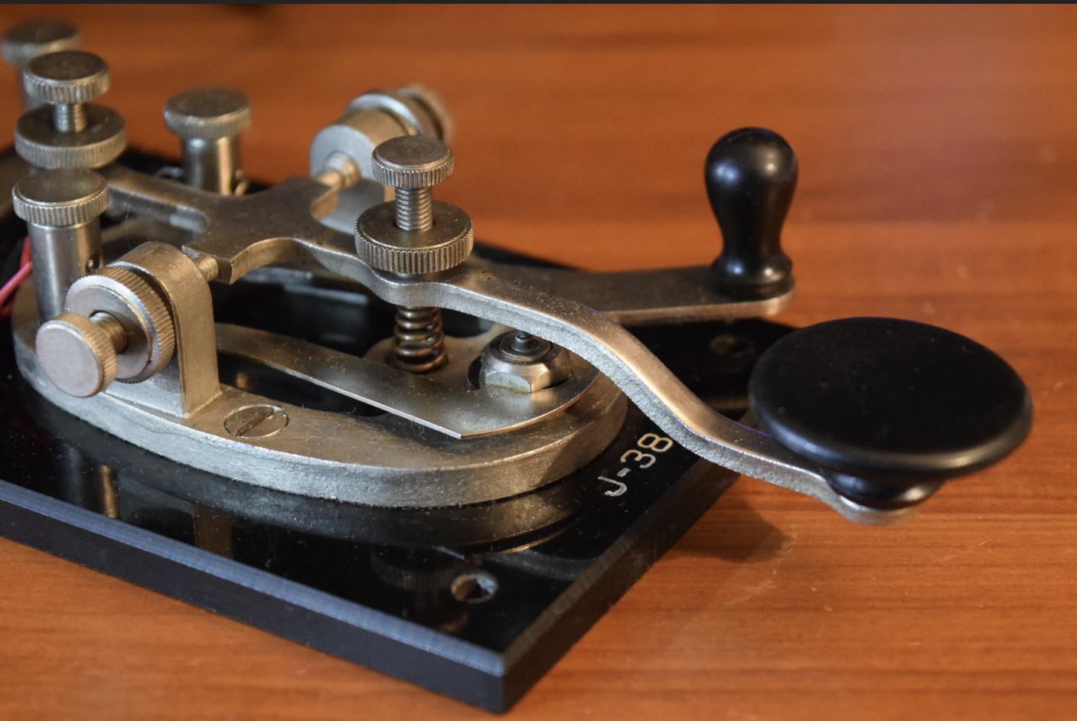
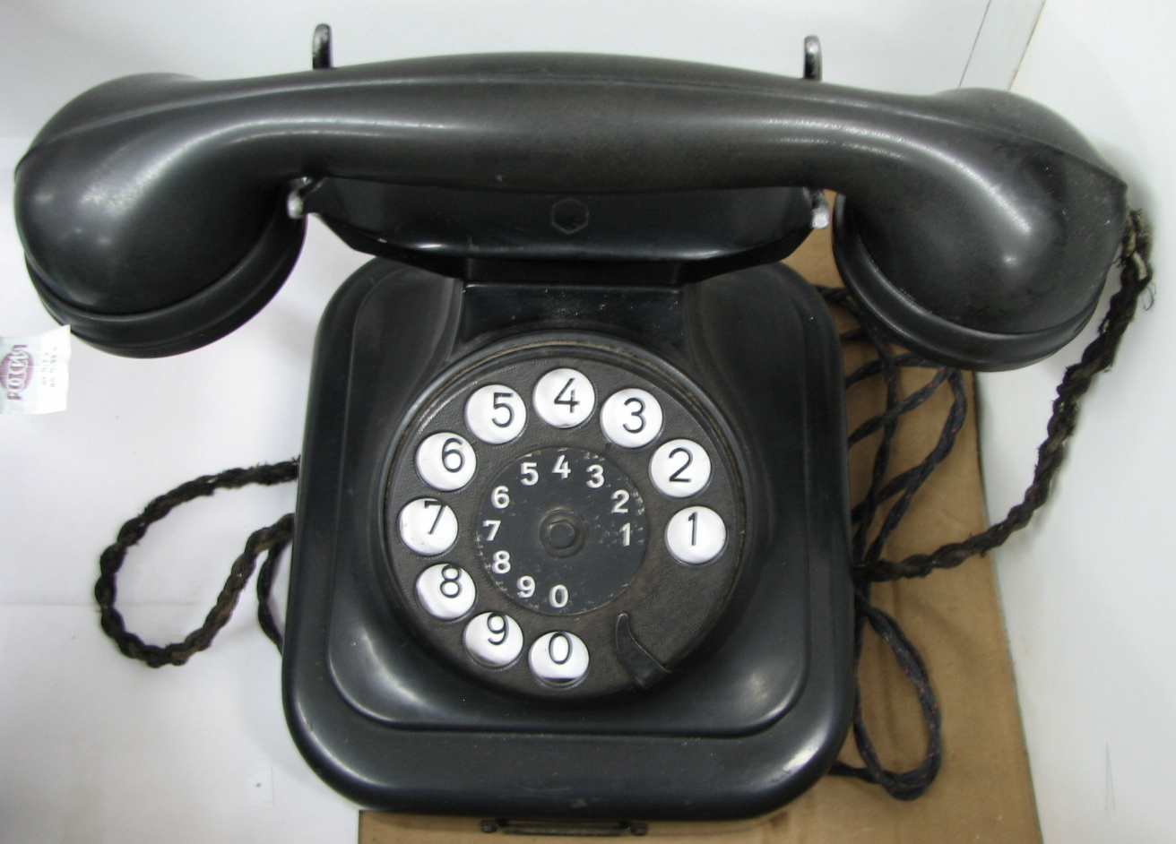
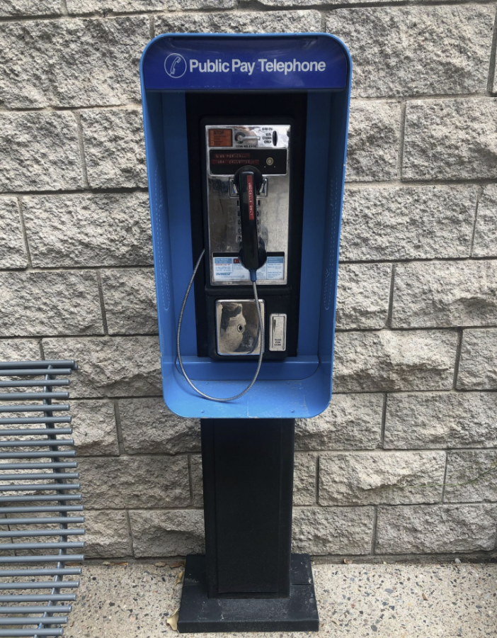
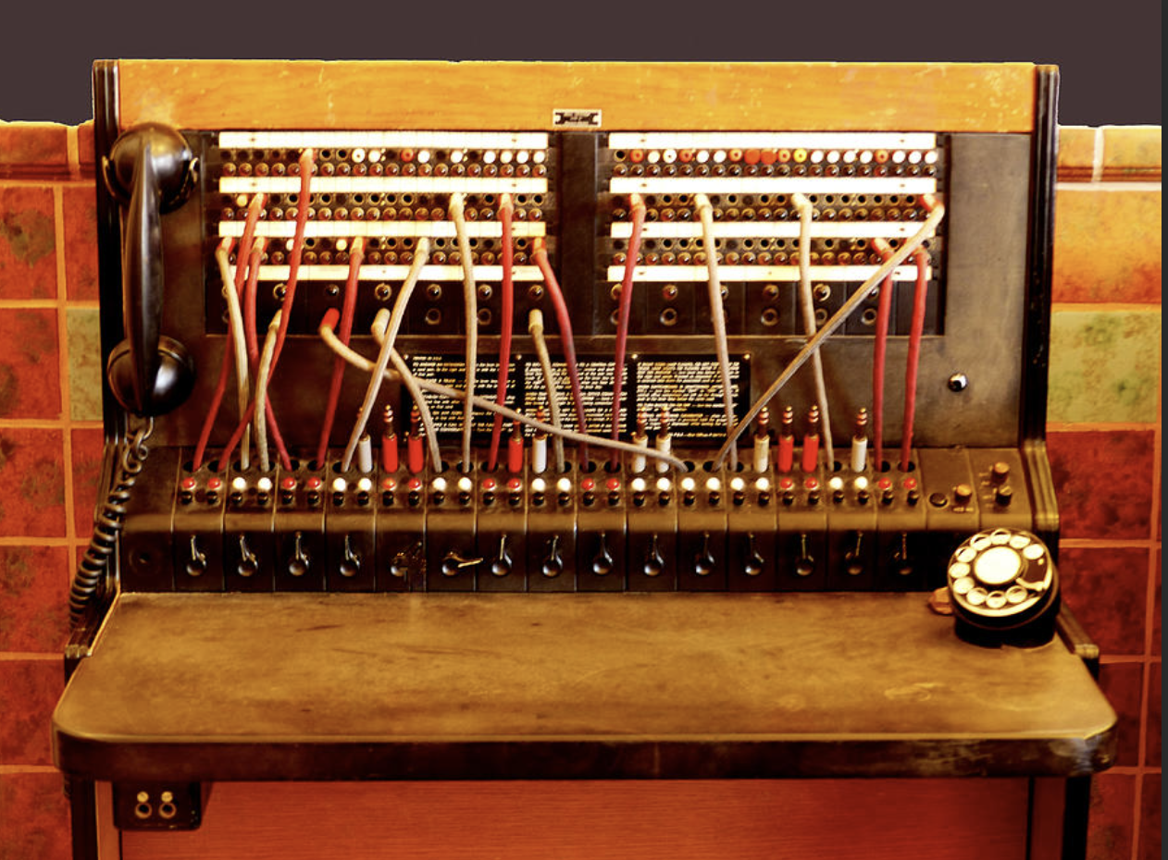
Key Historical lessons of Communication
Telegraph → Switchboard → Rotary Phone → Payphones
Source: thoughtco.com
Source: commonwealthfoundation.org
Source: fineartamerica.com
Source: payphone-project.com

Slide 4

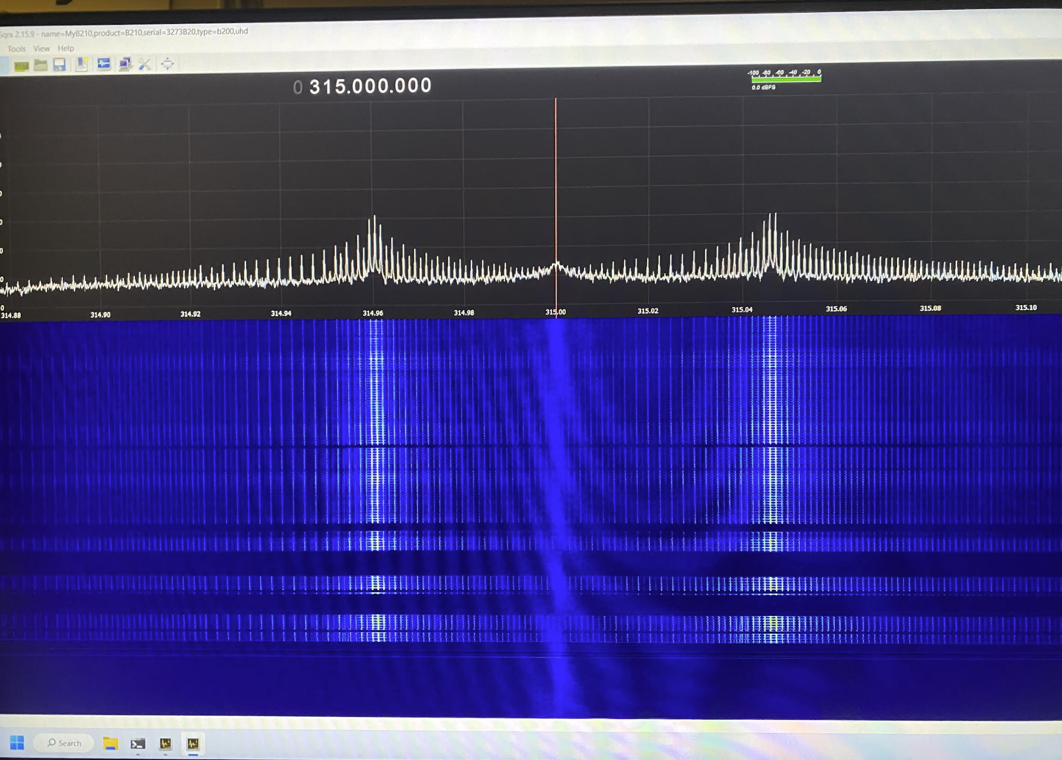
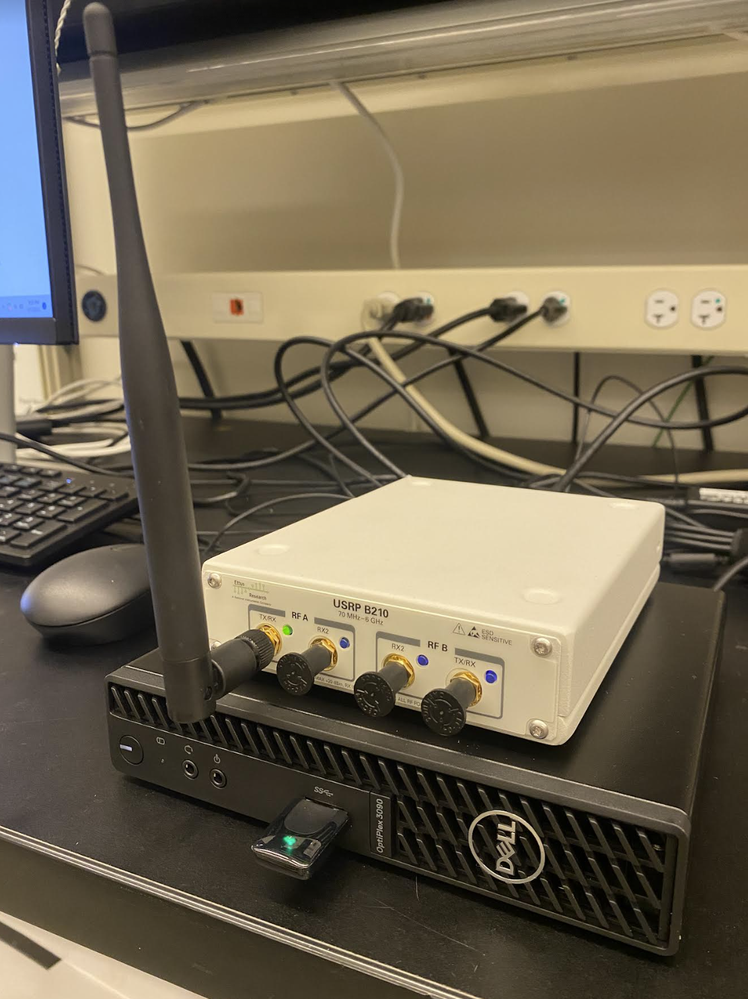
Relevant Technology
GNU Radio Companion
  Simulation and signal transmission software
Gqrx Software
  Radio Receiver Software
    Based on GNU Radio Software
USRP B210 Receivers
  Main hardware configured to the project software
Source: gnuradio.org

Slide 5
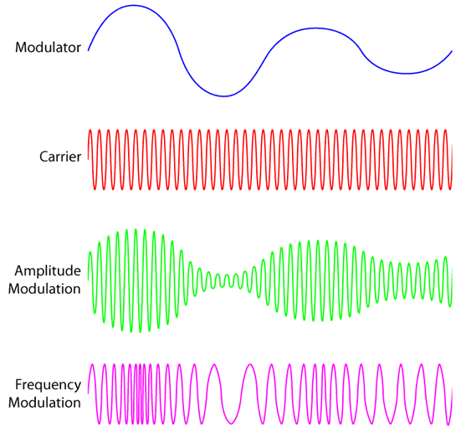
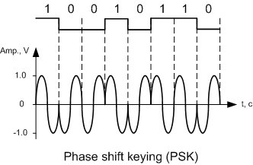
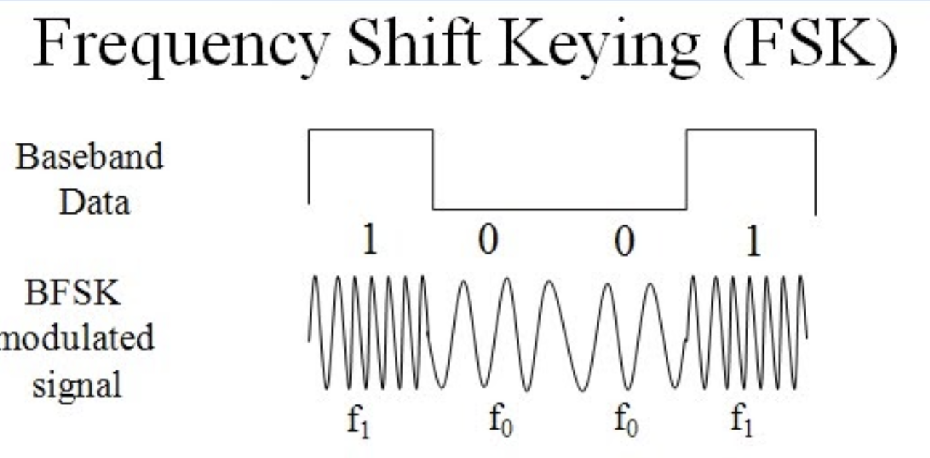
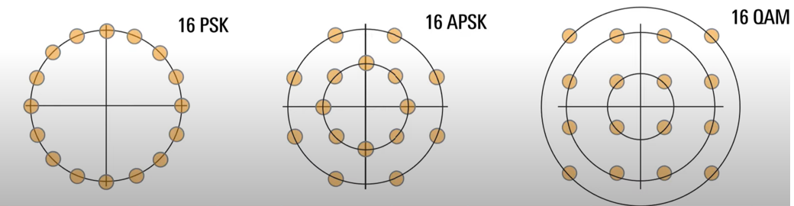
Understanding Modulation Techniques and satellite Communication
Analog Data Transmission
  Frequency and Amplitude Modulation (FM and AM)
Discrete Data Transmission
  Frequency vs Phase Shift Keying
  Quadrature Amplitude Modulation (QAM)
    IQ Modulation (In-phase/Quadrature)
  Amplitude and Phase Shift Keying (APSK)
    Primarily used for Satellite Communication
      Good with Amplitude effects
      Nonlinear amplification (Compression)
Source: quora.com
Source: watelectronics.com
Source: lasopabinary475.weebly.com
Source: youtube.com/Rohde Schwarz/Understanding APSK and QAM

Slide 6
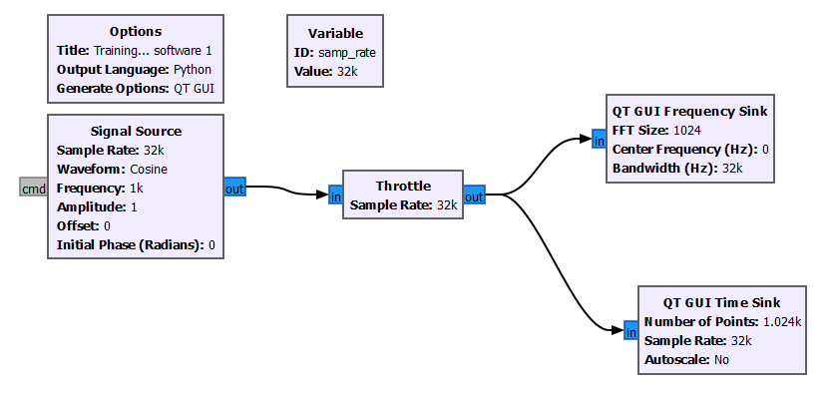
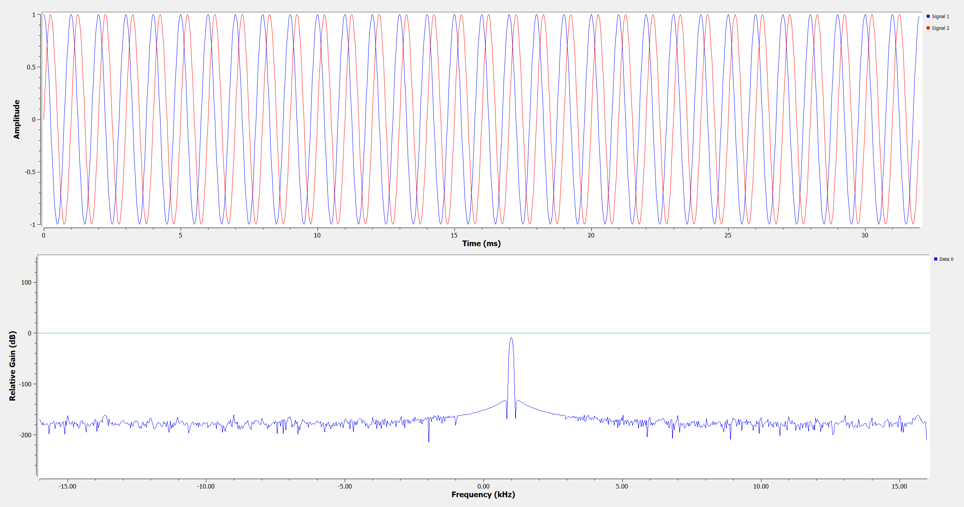

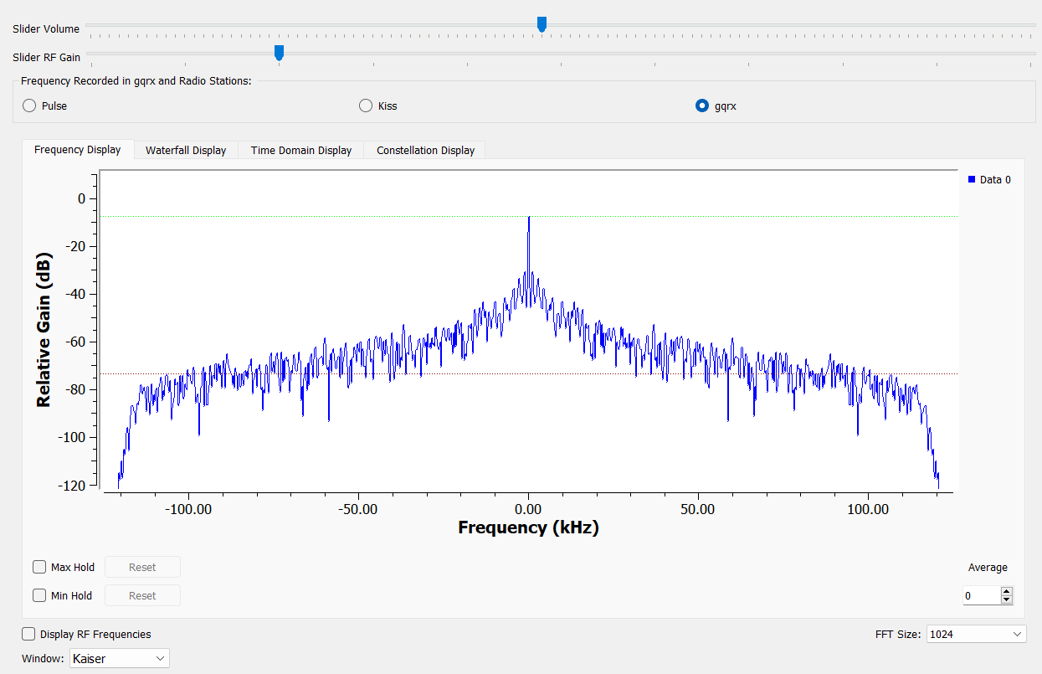
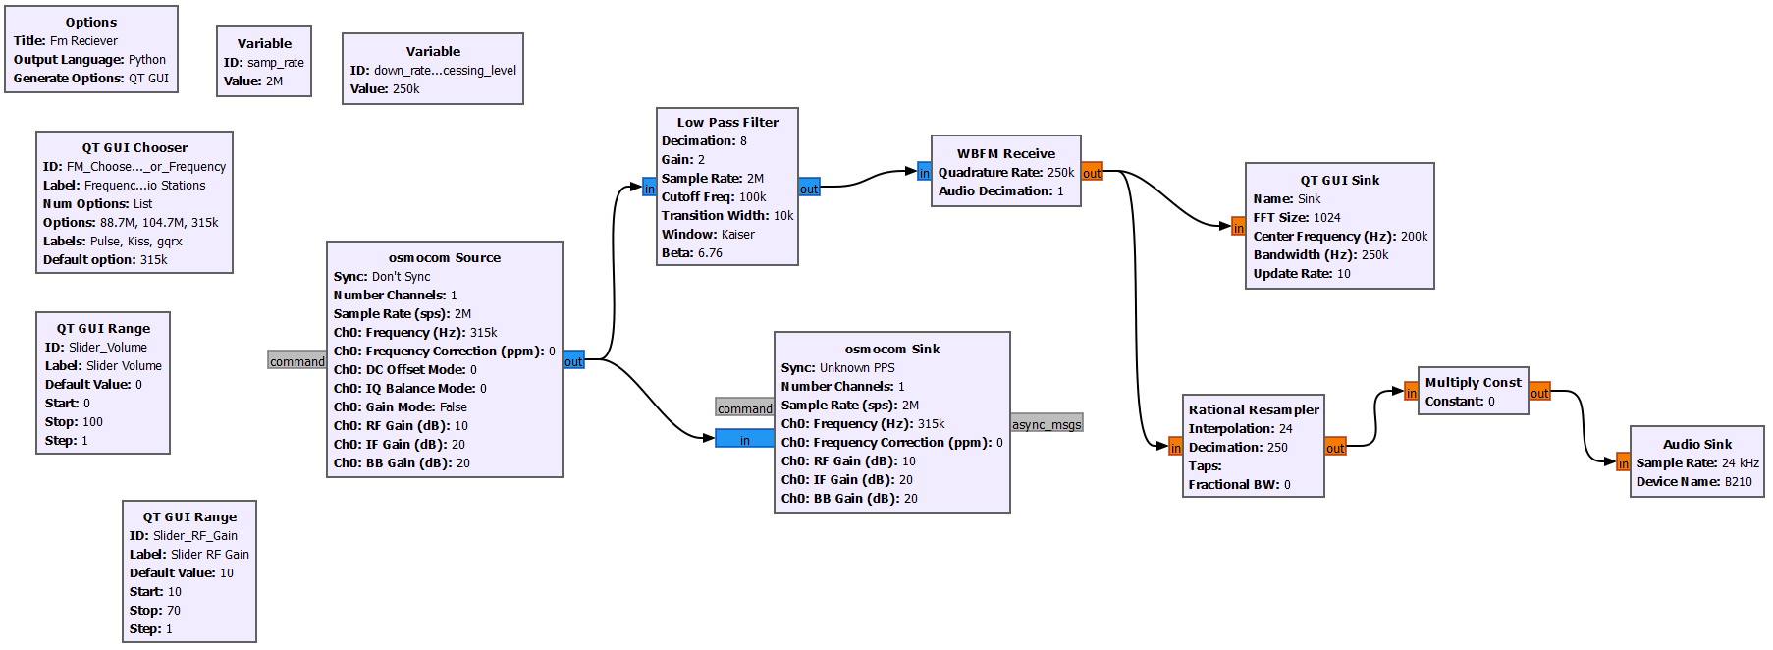
Simulation of Communication and Radio Frequency Reception (pt. 1)
Simple Cosine Waveform Simulation
Frequency Reception (Radio Station)

Slide 7
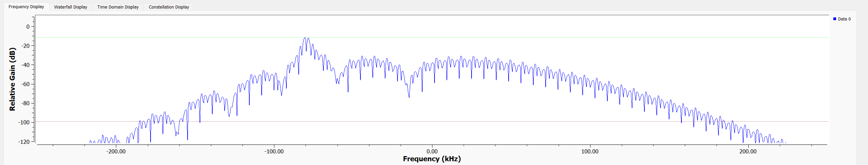
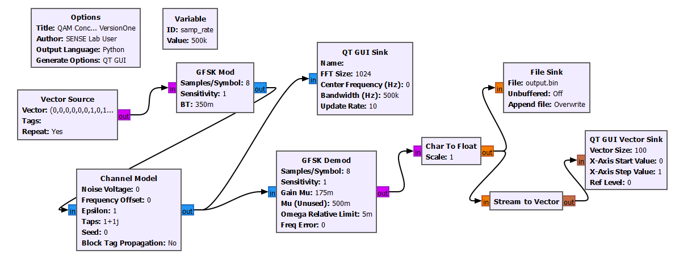
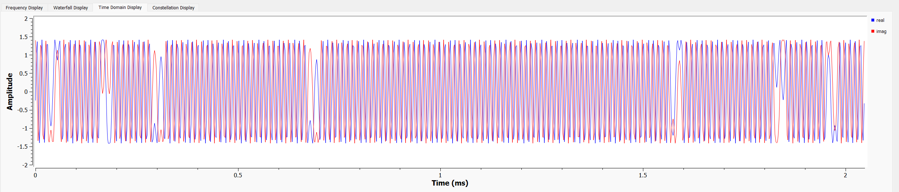
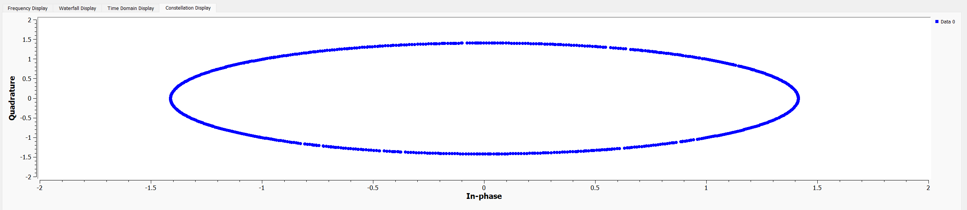
Simulation of Communication and Radio Frequency Reception (pt. 2)
Simple Gaussian Shift Keying Modulation and Demodulation

Slide 8
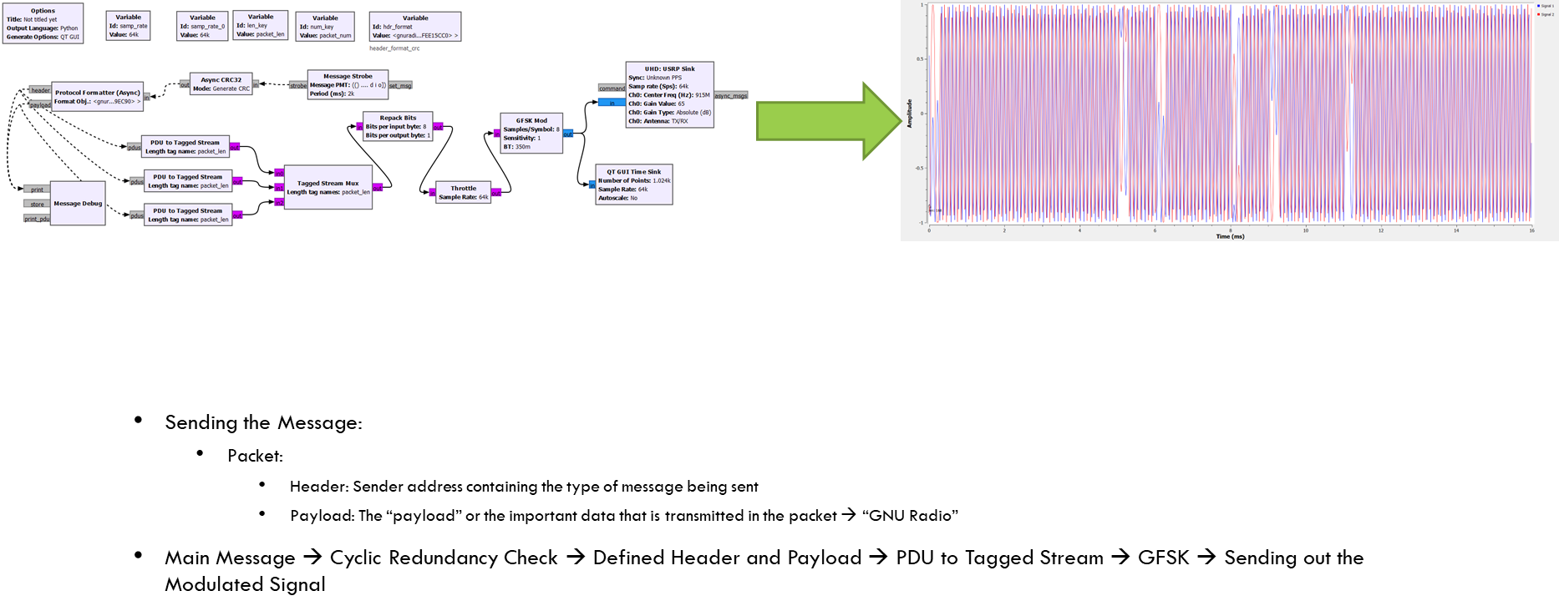
Results, Testing, observing data (Transmission)
Sending the Message:
  A “Packet” of information is sent
    Header: Sender address containing the type of message being sent
    Payload: The “payload” or the important data that is transmitted in the packet → “GNU Radio”
Main Message → Cyclic Redundancy Check → Defined Header and Payload → PDU to Tagged Stream → GFSK → Sending out the Modulated Signal

Slide 9
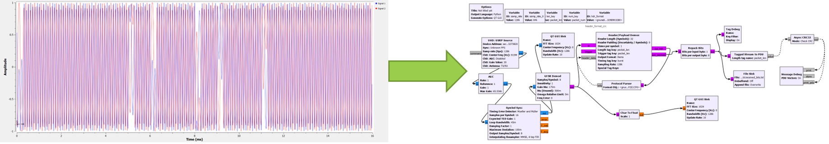
Results, Testing, observing data (Receiver Data pt. 2)
Receiving the Message:
  Receiver accepts the packet (after analyzing the Header’s packet information) and is broken into its Header and Payload components to isolate and process the Payload
Automatic Gain Control → Symbol Sync → GFSK Demodulation → Header/Payload Demux → Protocol Parser (for the Header data) → Tagged Stream to PDU → Cyclic Redundancy Check → Debug → Printed/Displayed

Slide 10
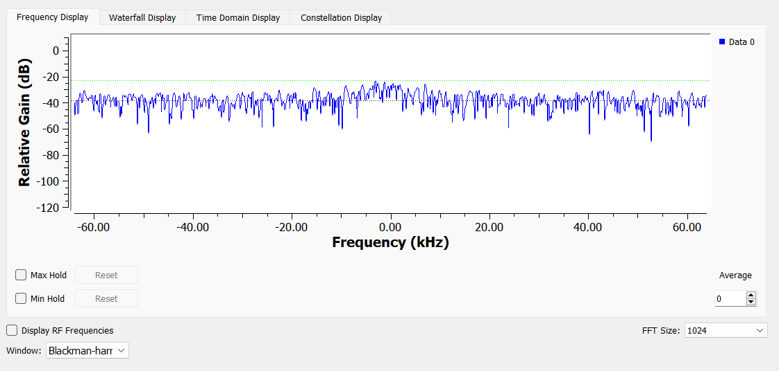
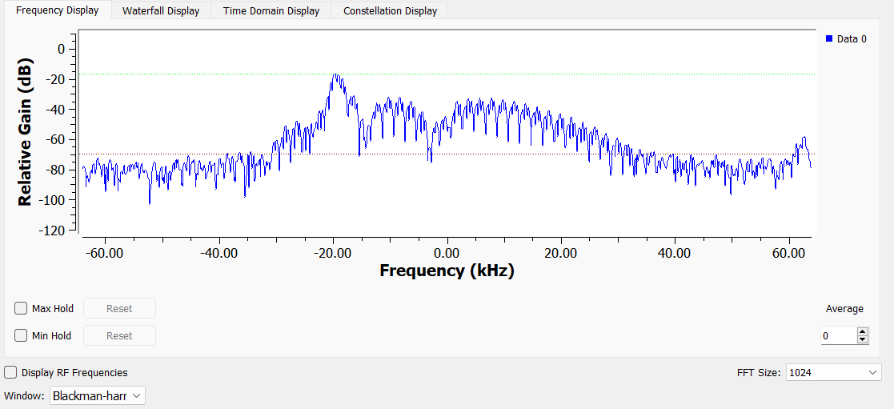

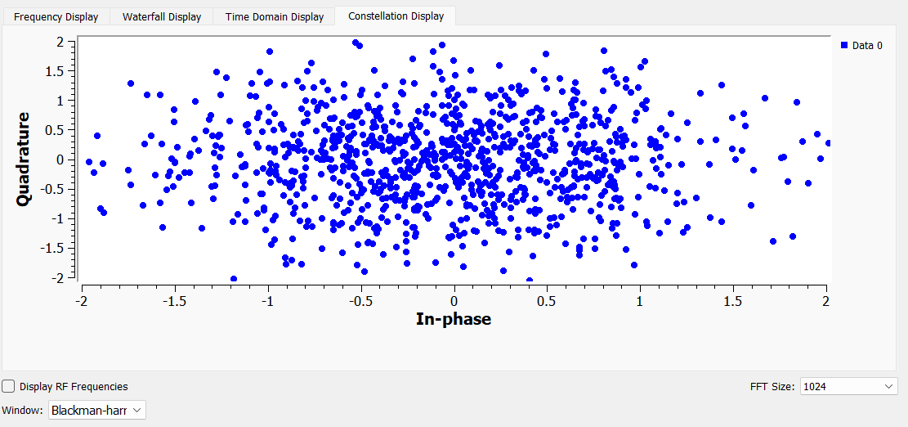
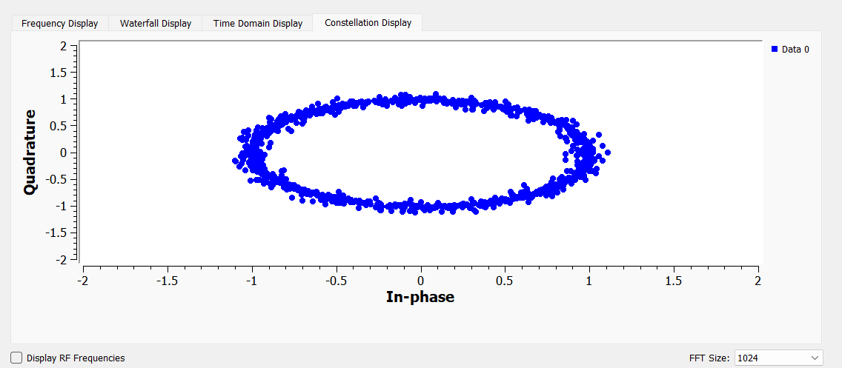
Results, Testing, observing data (Receiver Data pt. 2)

Slide 11
Overall takeaways
Taking Lab Transmission to Satellite Communication:
  Transmitting Data in a lab is different than in an environment filled with many different radio frequencies that can be classified as “noise”
    Improving Signal to Noise Ratio
  Transmission of signals to space requires other tools to get the message to travel long distances
    Repeaters, Transponders, Amplifiers, etc.
    Peak-to-Average-Power Ratio (PAPR)
  Higher Order of Modulation is needed depending on the information being sent
    Data Rates/Efficiency of data transfer

Slide 12
Acknowledgements
Dr. Sean Bryan: for his guidance, expert opinions, and patience
Scott Smas: for his connection and organization of my project
Desiree Crawl, Margaret Hufford, and Deborah Bair: for their communication of deadlines and volunteering opportunities
I would like to thank my mentors, Scott Smas and Dr. Sean Bryan, and The NASA Space Grant Program in its entirety for giving me the opportunity to work in a laboratory environment and become a more well-rounded STEM student

Slide 13
Thank You

